Slide 1

Web Project for Exchange Student
SKKUEXS
김주원 | 서현원 | 이하은 | 한희근
2023.03.24

Slide 2
Q&A

Slide 3
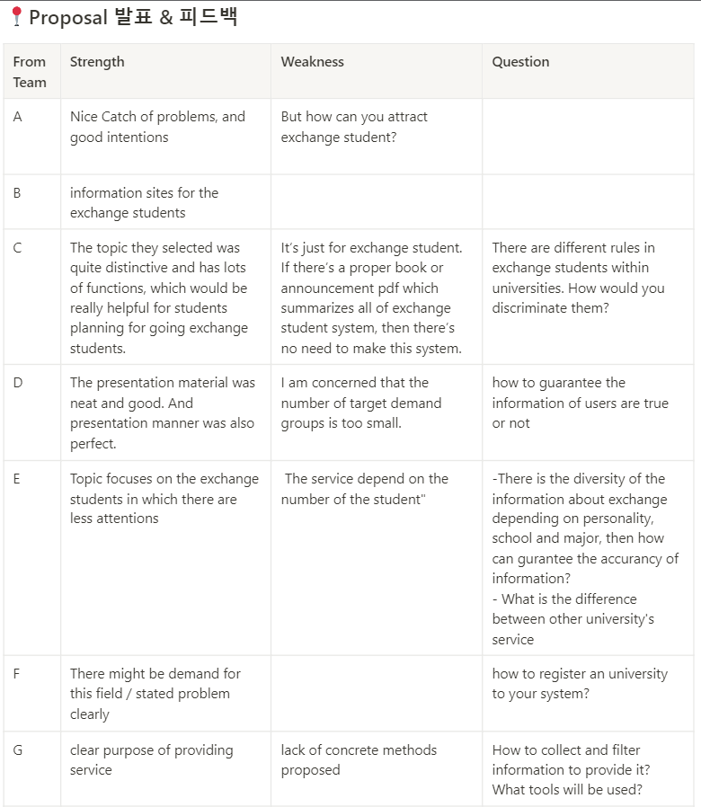

Slide 4
User

Slide 5
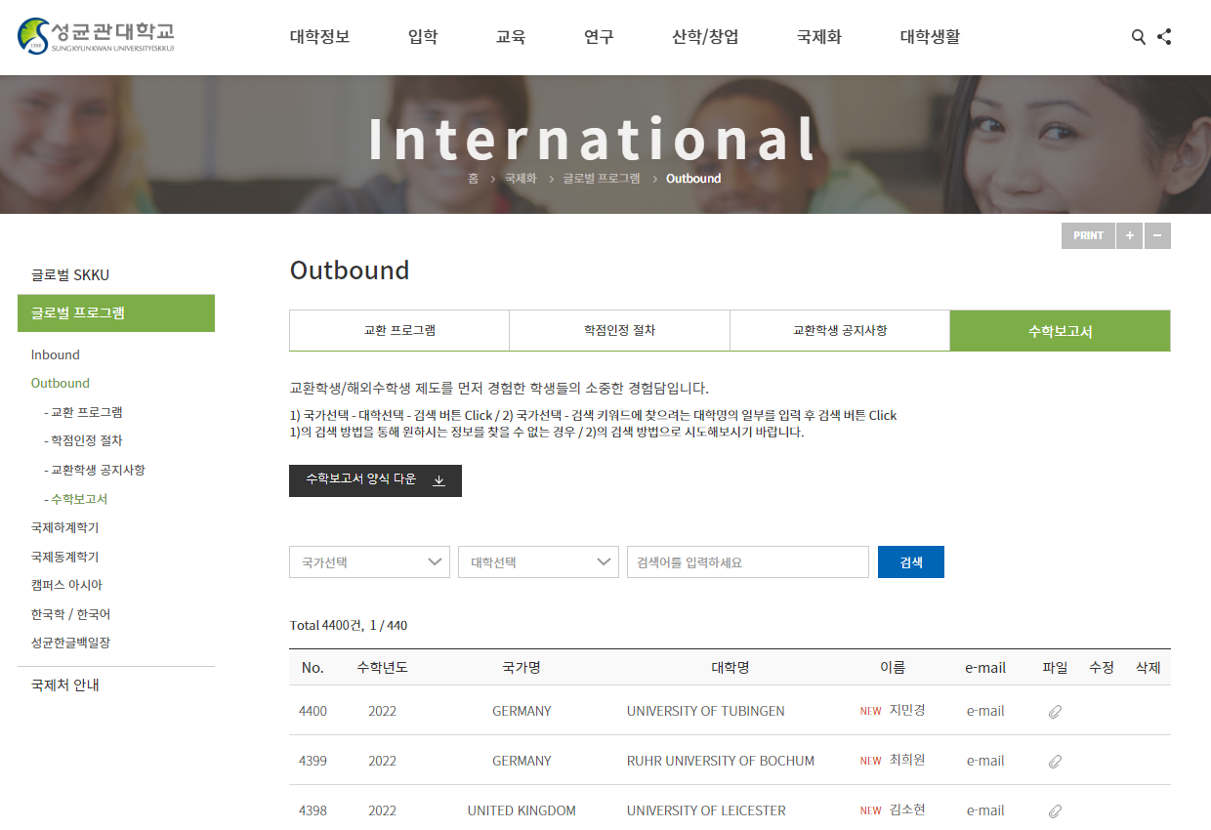
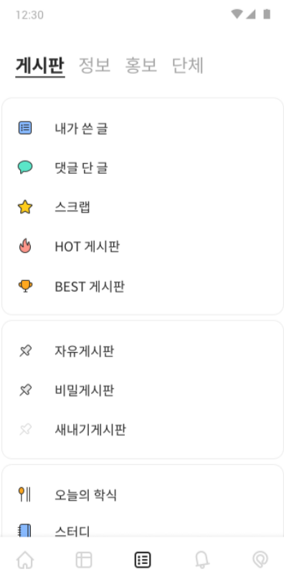

Q. How can you attract exchange student?
교환학생 수학보고서 정보 요약페이지

Slide 6
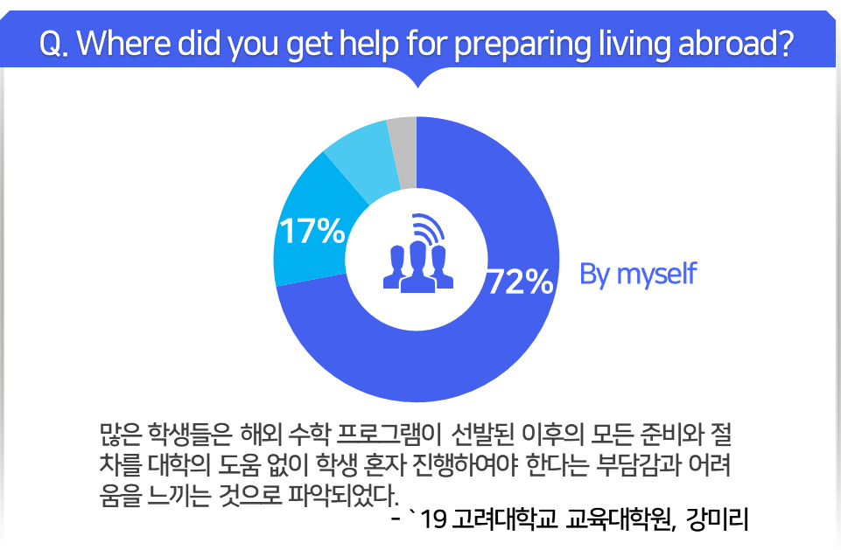
Q. Number of target demand is too small

Slide 7
Q. How to guarantee the information of users are true or not
Report function
Consider frequency of information

Slide 8
Service

Slide 9

Q. Does this service really need?

Slide 10
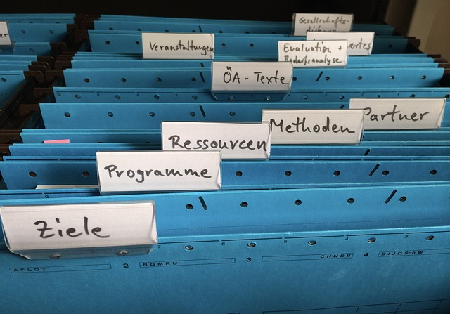
Q. How to deal with differences.

Slide 11
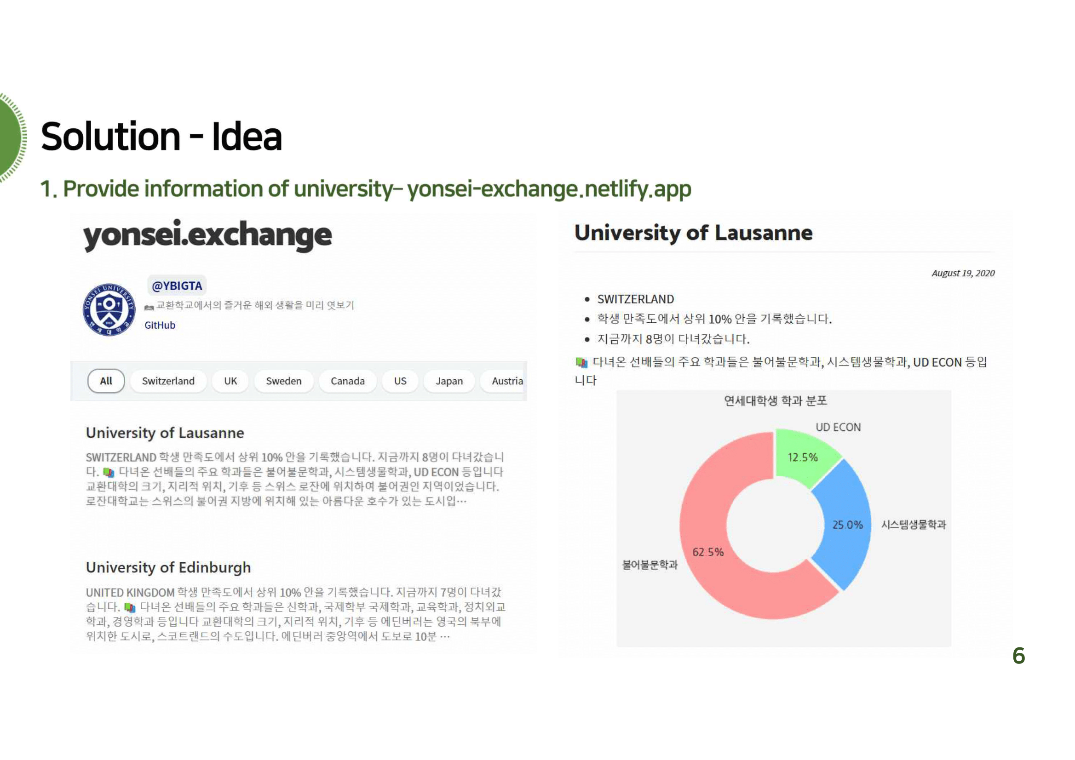
Q. Difference between other service.

Slide 12
Method

Slide 13
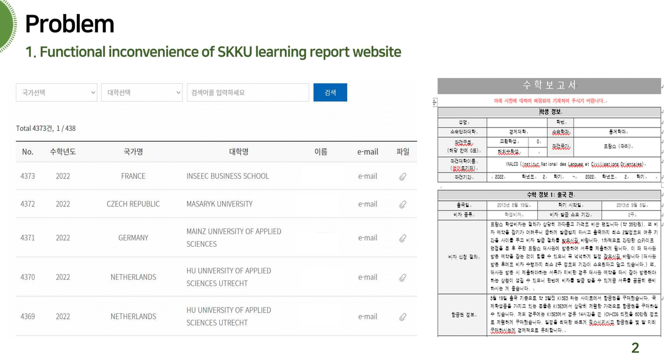
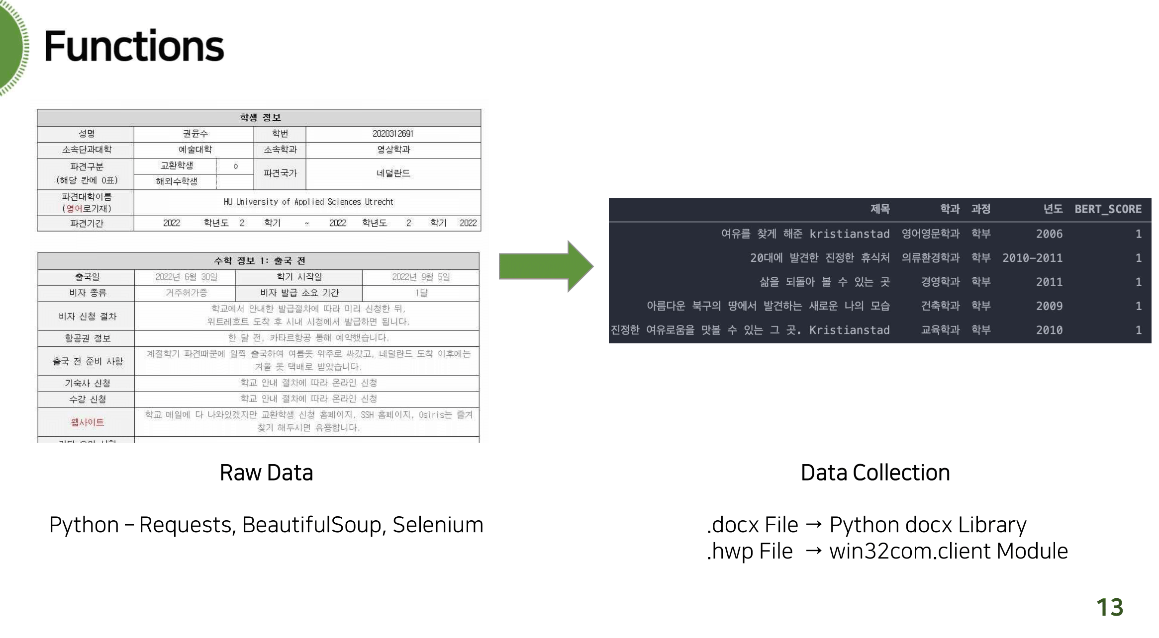
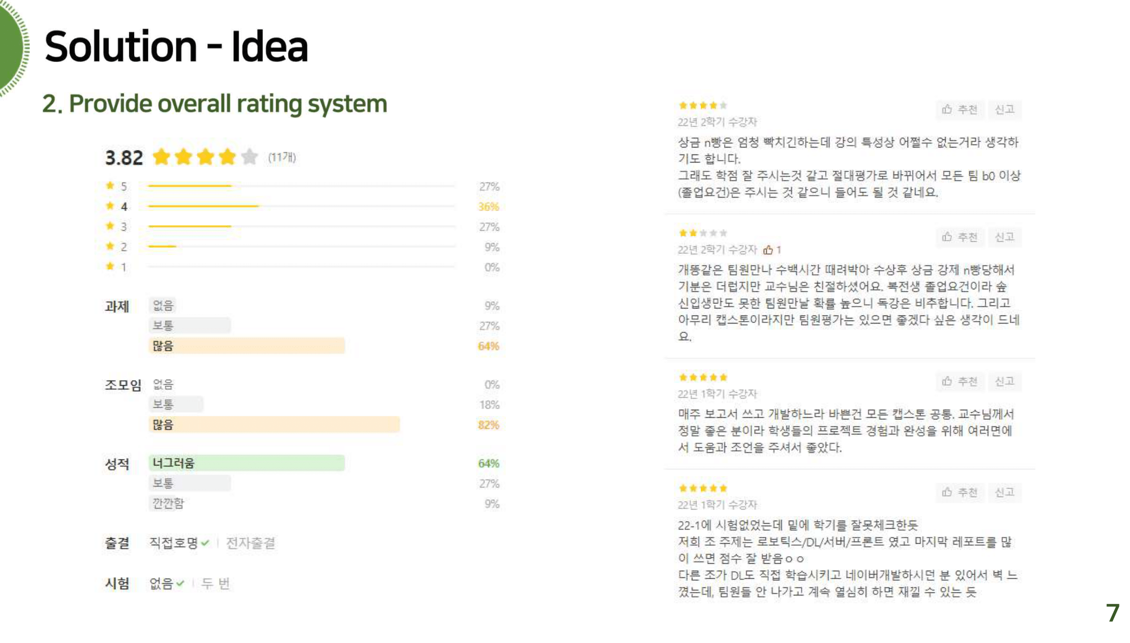
Q. Overall methods.

Slide 14
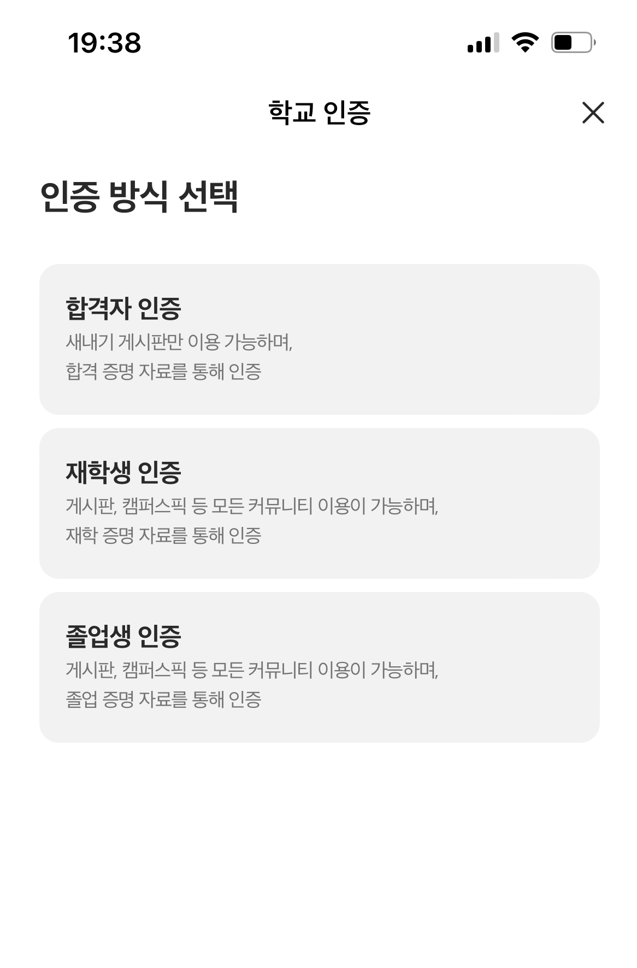
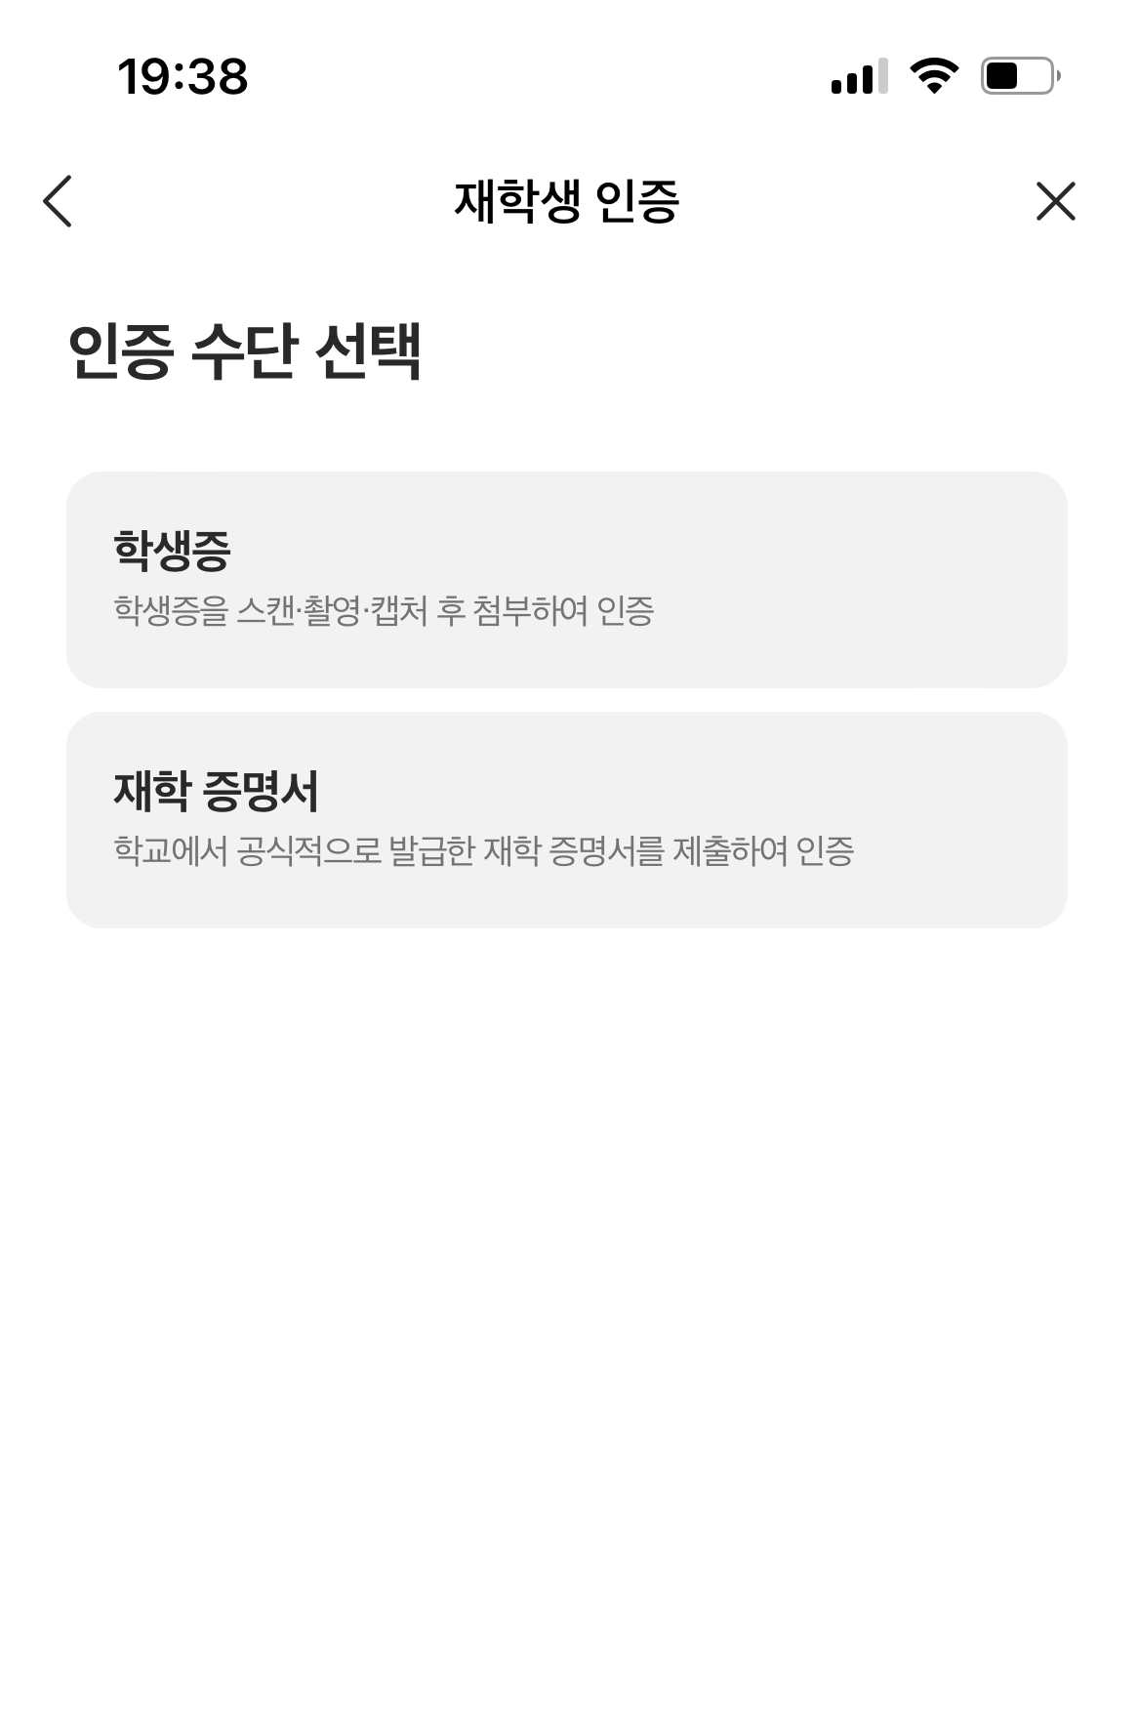
Q. How to check user’s university.

